Slide 1

SDSU HealthLINK Center for Transdisciplinary Health Disparities research
Funder: National Institute for Minority Health and Health Disparities (U54MD012397); MPIs: Guadalupe X. Ayala, MA, PhD, MPH and Kristen Wells, PhD.

Slide 2
Research Infrastructure Core Co-leaders
Guadalupe X. “Suchi” Ayala,
Co-Lead
Scott Kelley, Co-Lead
Ming-Hsiang “Ming” Tsou Co-Lead
Kristen Wells, MPI Lead, Co-Lead
Kee Moon, Co-Lead
Yusuf Ozturk, Co-Lead
Julie Pickrel, Center Research Manager

Slide 3
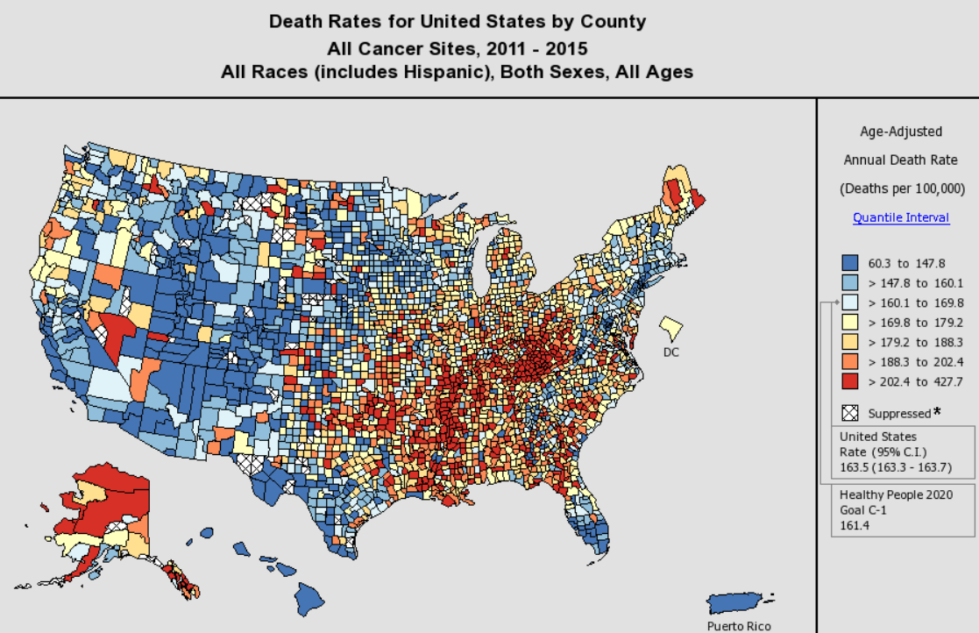
Cancer Disparities
Some cancers are caused by random mutations.
Some cancer are caused by other factors (gene, behaviors, diets, environmental factors)

Slide 4
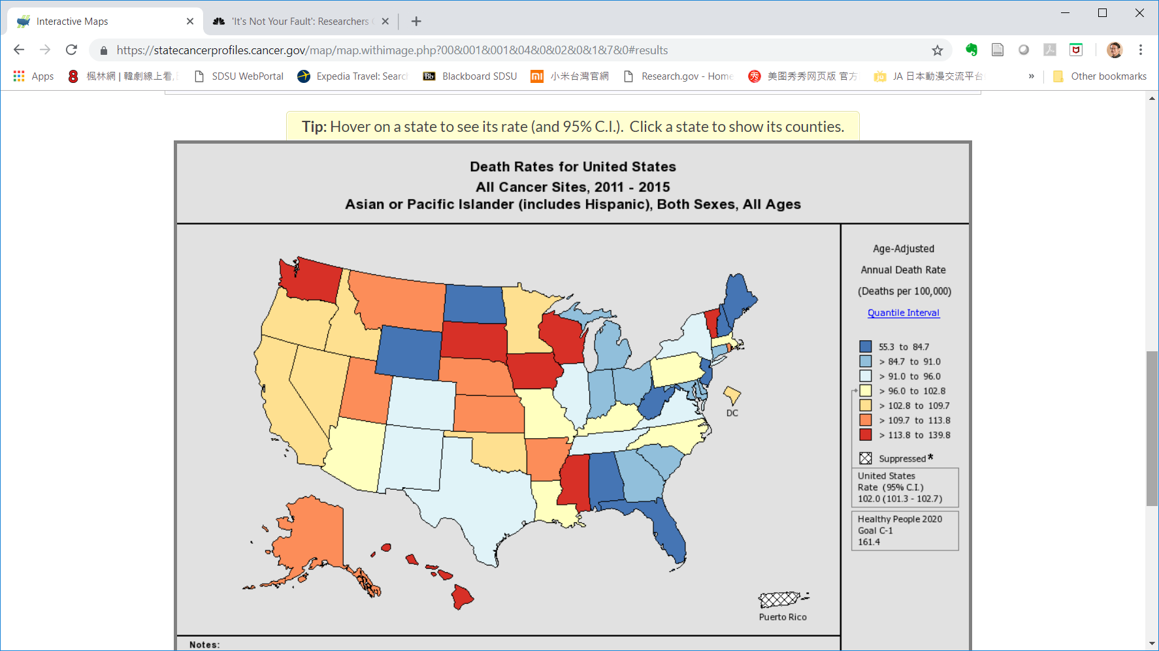
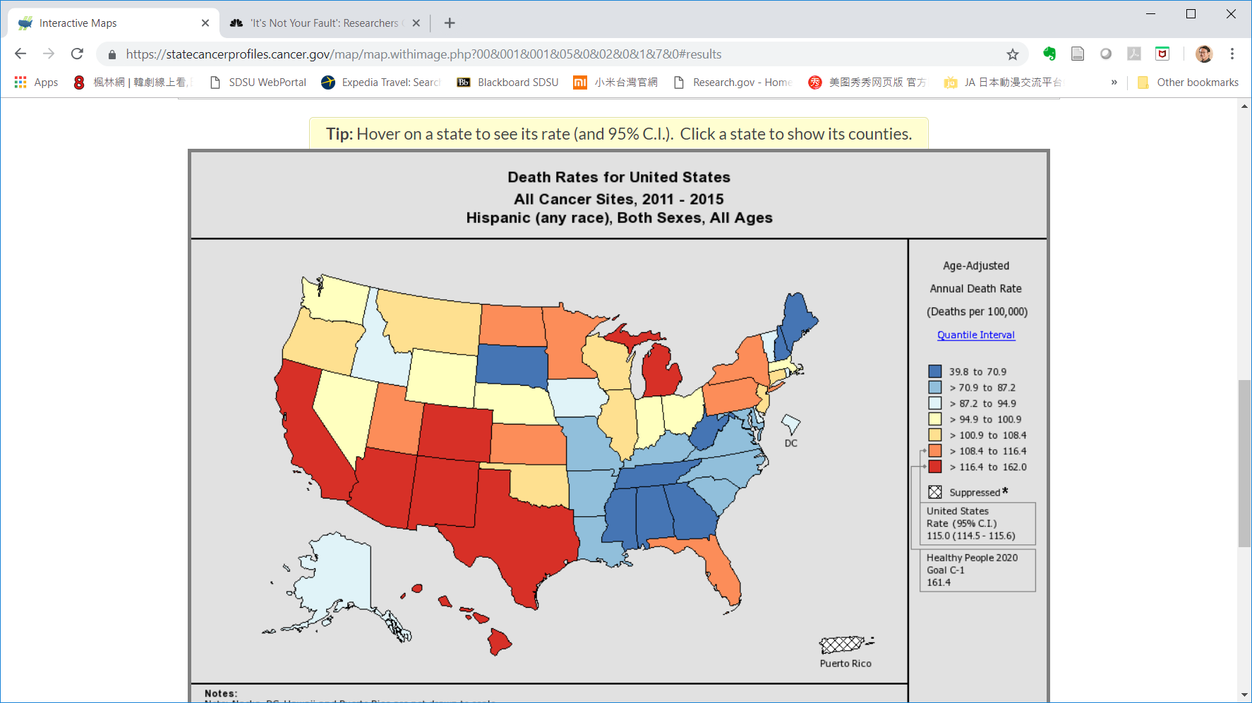
All Cancer Death Rate
(2011-2015) – Age-Adjusted
Asian / Pacific Islander
All Cancer Death Rate
(2011-2015) – Age-Adjusted
Hispanic

Slide 5
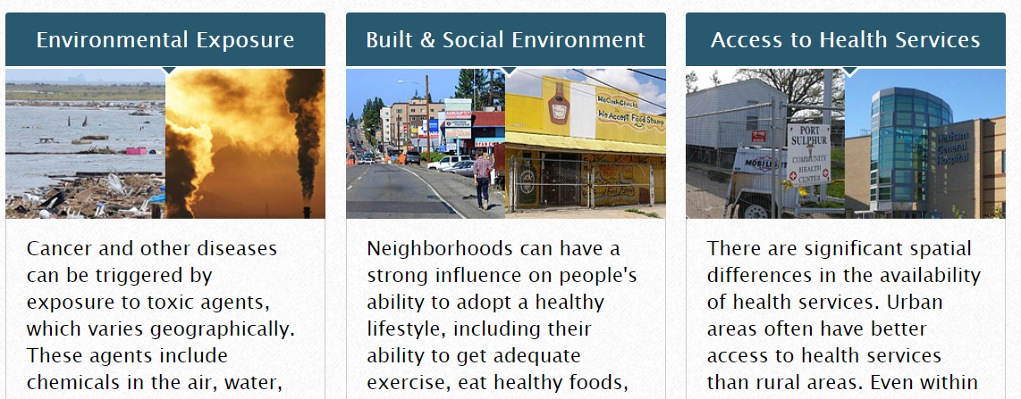
Geography Matters!

Slide 6
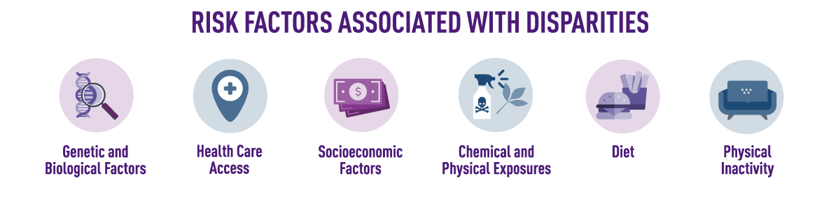
What is Cancer Disparity?
Cancer disparities are thought to reflect the interplay of socioeconomic factors, culture, diet, stress, the environment, and biology.
Which Factor is Modifiable?
https://www.cancer.gov/about-cancer/understanding/disparities

Slide 7
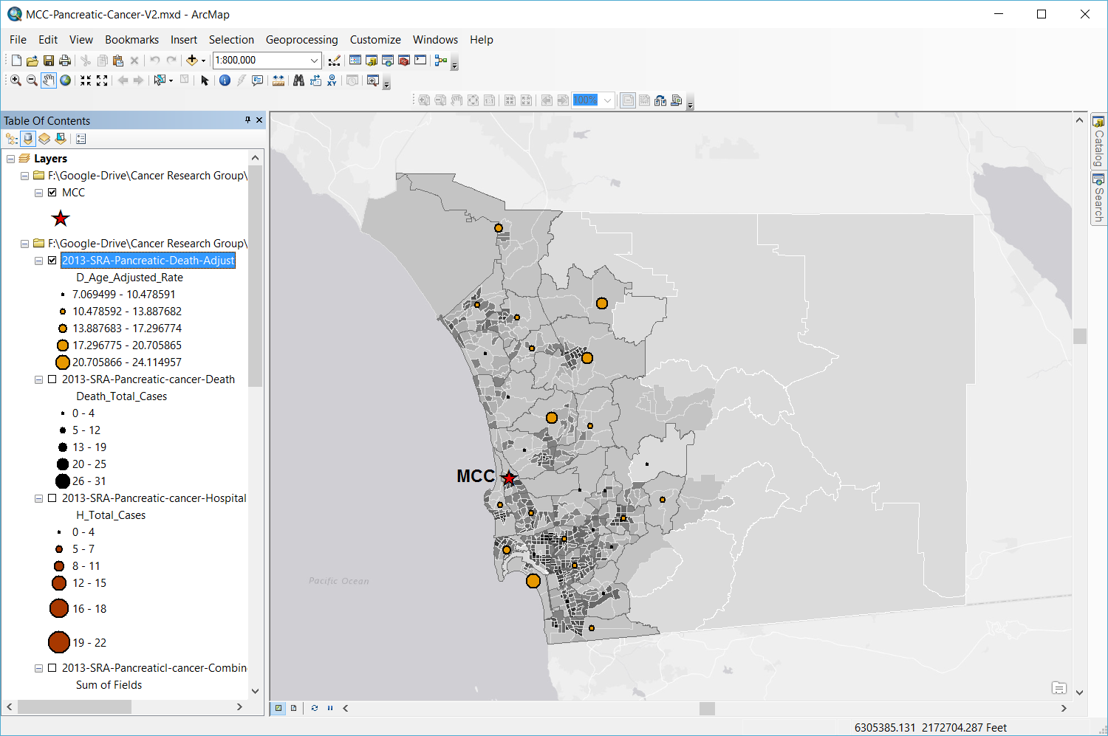
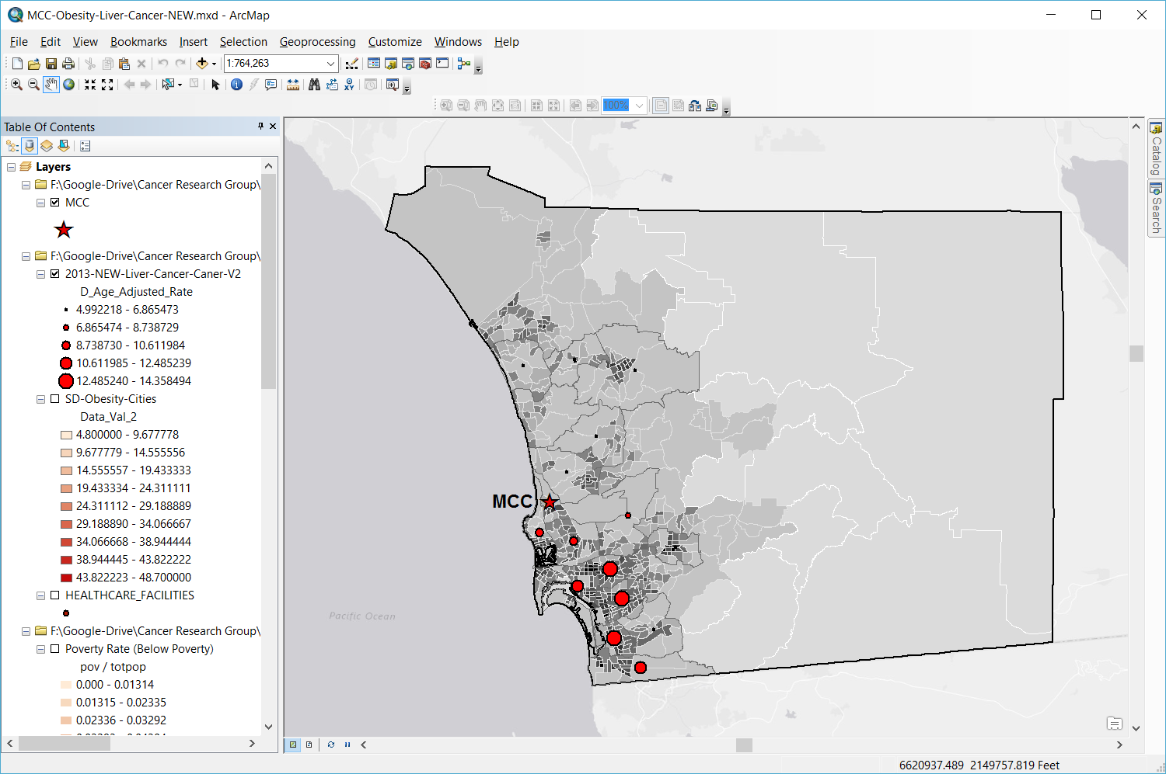
Pancreatic Cancer (brown) and Liver Cancer (red) Death Age-Adjusted Rates 2013 in San Diego County
Population Density
Pancreatic Cancer
Liver Cancer
low
high
Pancreatic
Cancer
Death Rates
low
high
Liver
Cancer
Death Rate
low
high
Notes:
Decrease font of text in bottom/middle box

Slide 8
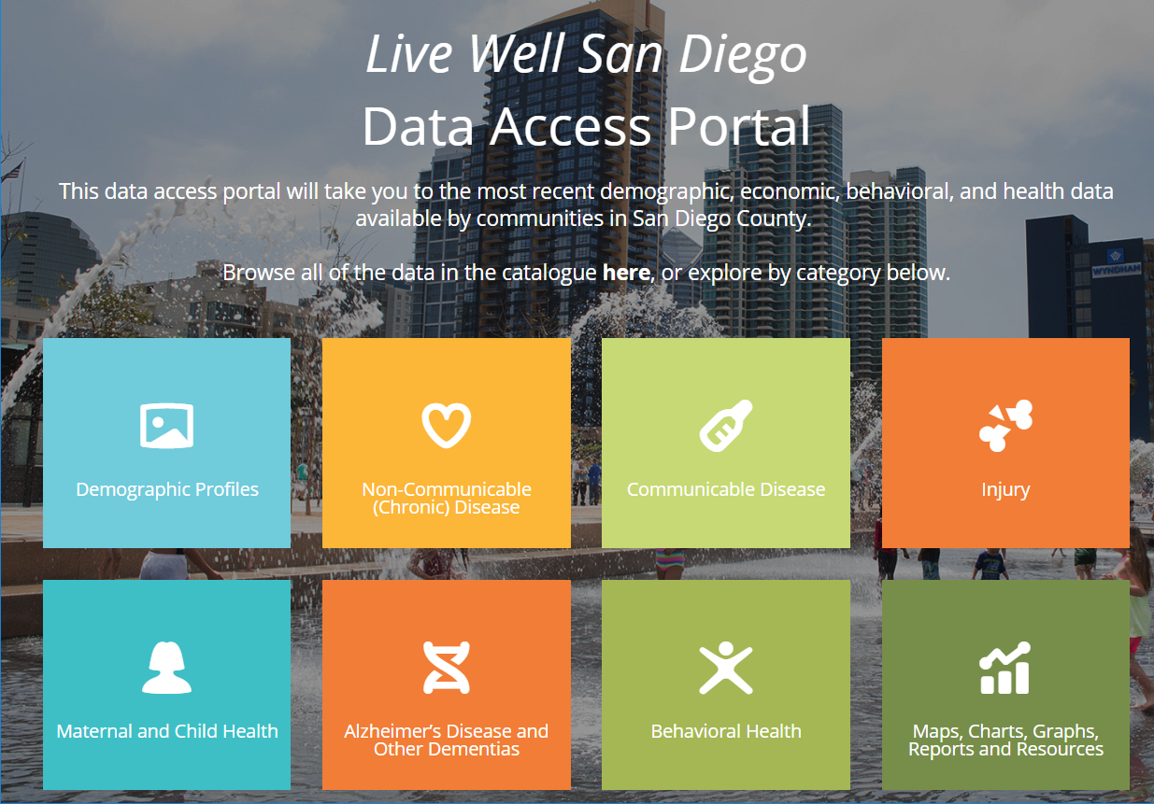
https://data.livewellsd.org/

